Slide 1

IDAM Holiday Readiness 2024
SailPoint IIQ

Slide 2
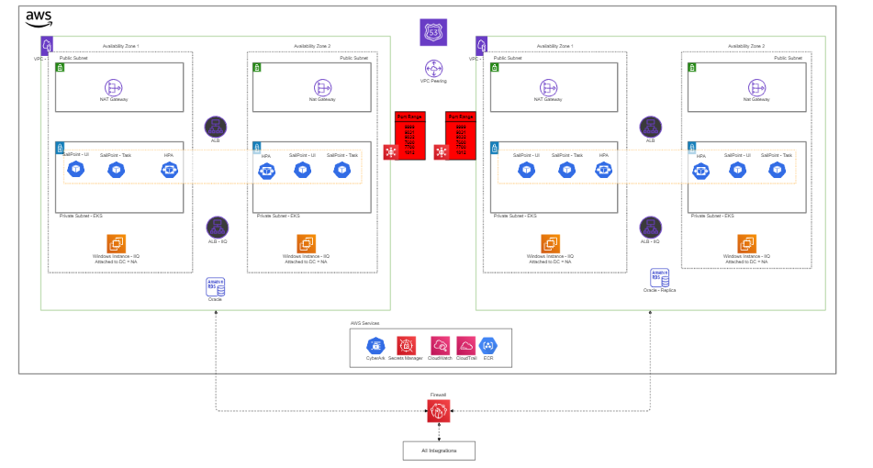
BBY SailPoint IIQ Architecture
Wiki Link: IIQ Implementation Summary - Identity and Access Management - Confluence (bestbuy.com)

Slide 3
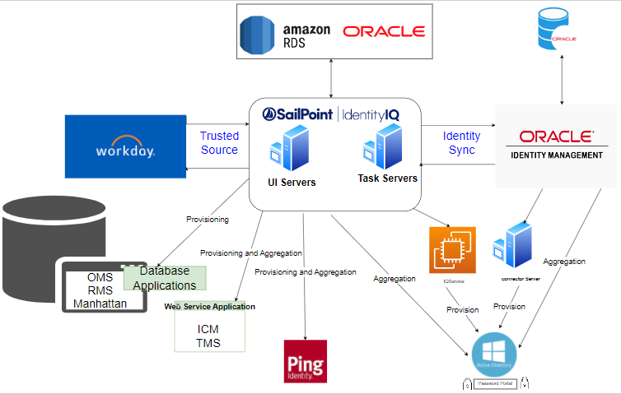
BBY SailPoint IIQ Component Architecture
Wiki Link: IIQ Implementation Summary - Identity and Access Management - Confluence (bestbuy.com)

Slide 4
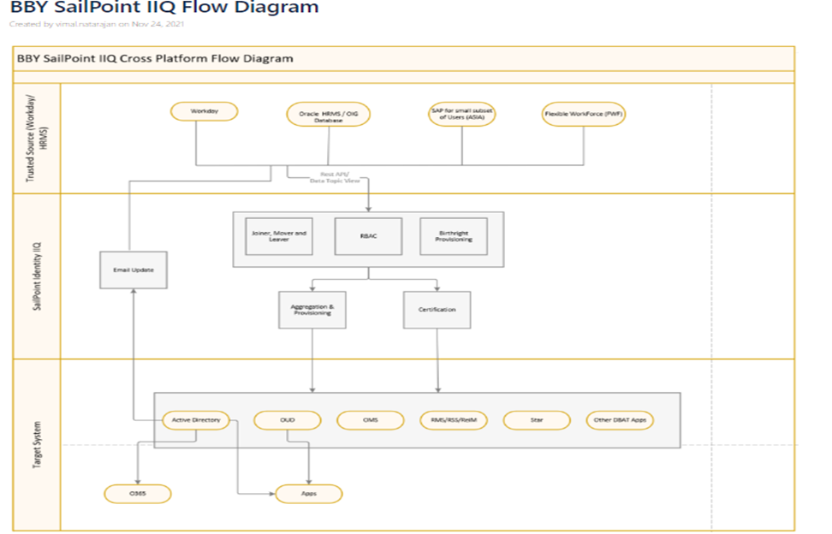
BBY SailPoint IIQ Flow Diagram
Wiki Link: BBY SailPoint IIQ Flow Diagram - Identity and Access Management - Confluence (bestbuy.com)

